Slide 1
Radiology
Careers in Radiology

Slide 2
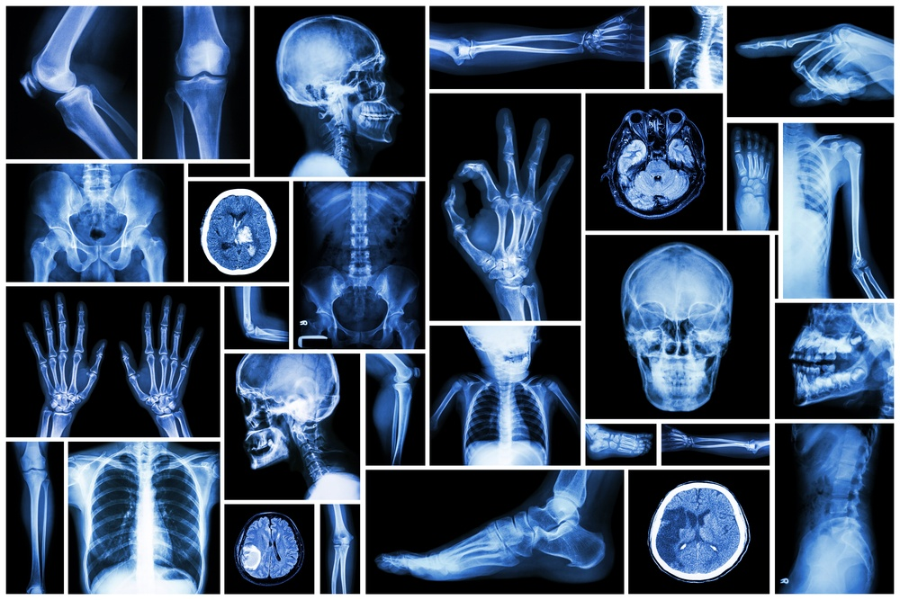
https://youtu.be/OvnJj_nlvzU

Slide 3
What are their responsibilities?
They are responsible for explaining and getting patients ready for radiological tests and treatment that will be performed. They place the equipment at the right distance and correct angle from the patient to make the appropriate images for the physician.

Slide 4
What technology does a Radiology Technician use?
X-Ray Machines
Ultrasound Machines
MRI (magnetic resonance imaging) scanners
PET (positron emission) scanners
Other technologically advanced machines to help diagnose and treat illnesses and injuries under the direction of a physician.

Slide 6
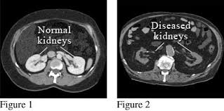

Slide 7
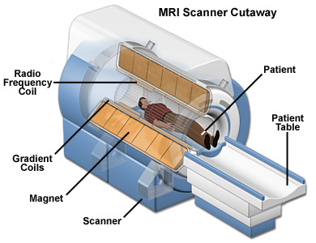

Slide 8
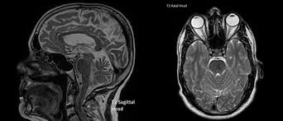

Slide 9
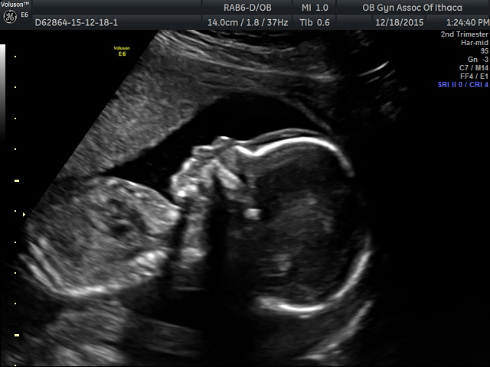

Slide 10
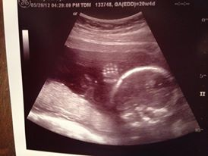

Slide 11
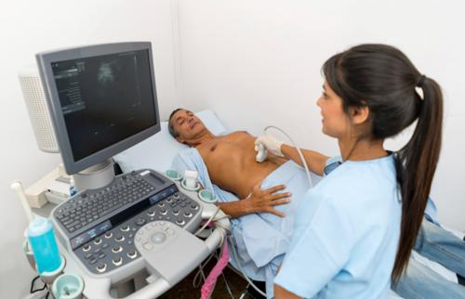

Slide 12
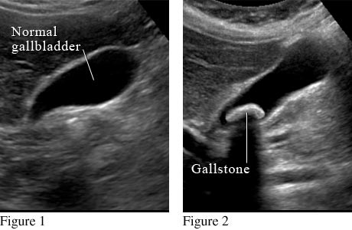

Slide 13
Radiology technicians also assist physicians in performing sophisticated procedures.
It is their responsibility to ensure that the radiology equipment is properly maintained.

Slide 14
Locations & Education
Radiology technicians work in:
Hospitals
Clinics
Medical laboratories
Nursing homes
Private industries
Education Requirements:
Must complete a two-year training program in a hospital or at a college (some colleges award this with an associate degree.
Average Salary:
$24,000 to $38,500 per year

Slide 15
What is the difference between radiologists and a radiology technician?
A radiologist is a medical doctor who interprets radiological images. They can also perform procedures and surgeries related to radiological procedures (biopsy tumors, drain fluids, open arteries and veins, etc.). A radiology technician takes the images.

Slide 16
Human Anatomy
The human skeleton consists of 206 bones. We are actually born with more bones (about 300), but many fuse together as a child grows up. These bones support your body and allow you to move. Bones contain a lot of calcium (an element found in milk, broccoli, and other foods). Bones manufacture blood cells and store important minerals.
The longest bone in our bodies is the femur (thigh bone). The smallest bone is the stirrup bone inside the ear. Each hand has 26 bones in it. Your nose and ears are not made of bone; they are made of cartilage, a flexible substance that is not as hard as bone.

Slide 17
Human Anatomy
Joints: Bones are connected to other bones at joints – knee, elbow, shoulder, hip, wrist, ankle, etc.
Difference in male and female bones: Males and females have slightly different skeletons, including a different elbow angle. Males have slightly thicker and longer legs and arms; females have a wider pelvis and a larger space within the pelvis, through which babies travel when they are born.

Slide 18
Practice Radiologist
Work with your group to review the x-ray images. Use the Human Skeleton sheet to help you identify the bones shown in the images then use that information to match the image to the correct diagnosis on the worksheet.

Slide 19
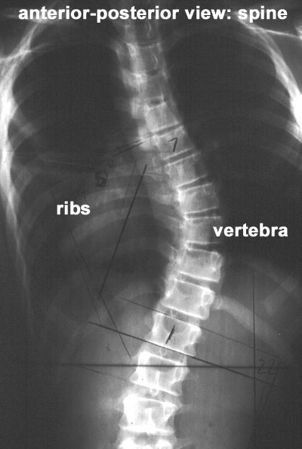
1

Slide 20
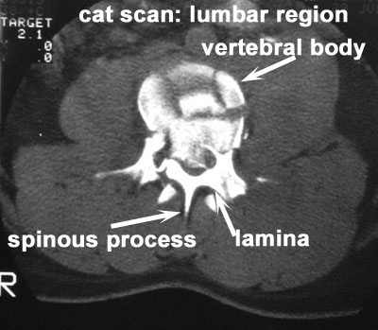
2

Slide 21
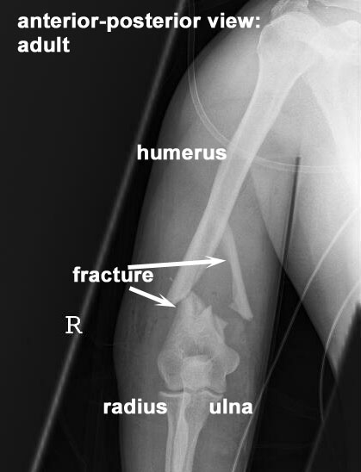
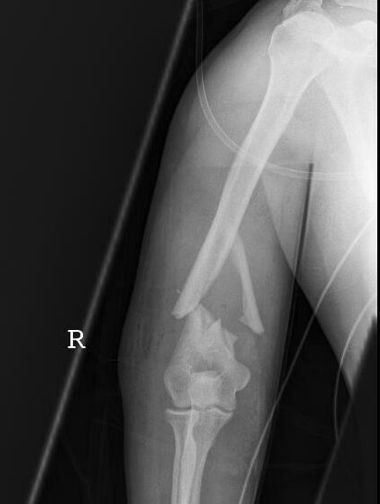
3

Slide 22
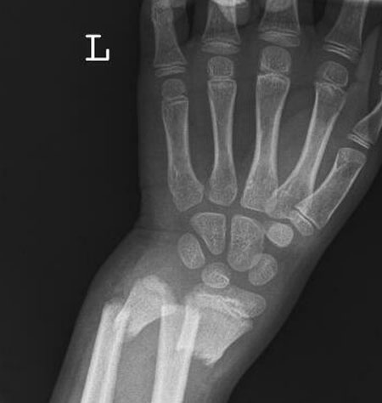
4

Slide 23
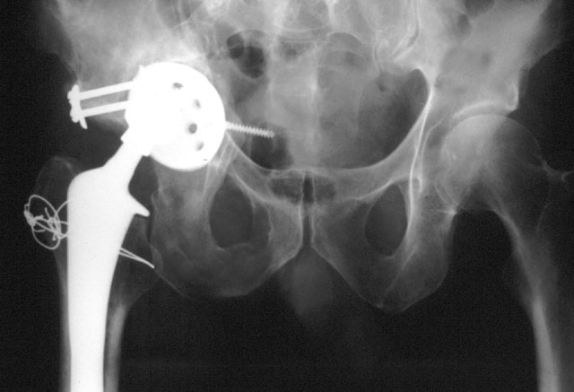
5

Slide 24
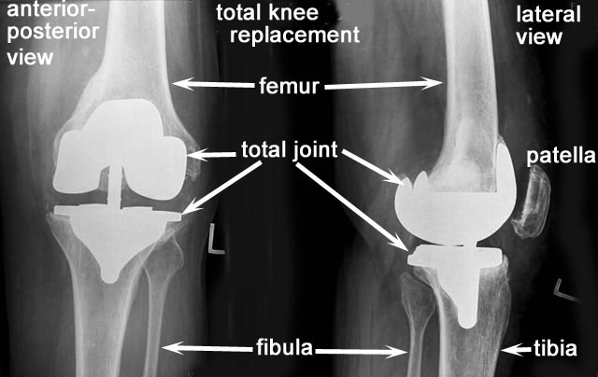
6

Slide 25
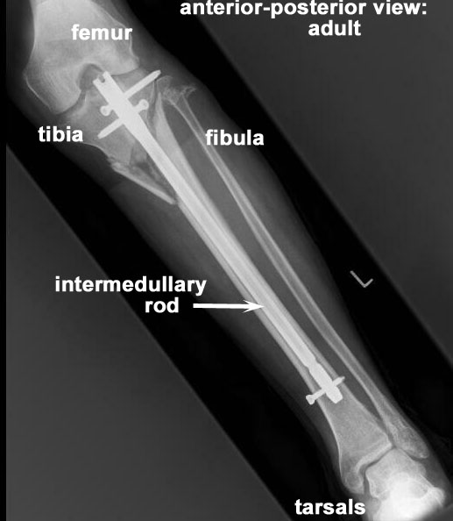
7

Slide 26
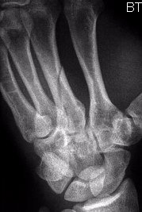
8

